Slide 1
Housing in Ames:
Predicting housing sales prices
through linear modelling
Mathea Stevens

Slide 2


Problem Statement or Business Opportunity
Ames Iowa, home to Iowa State University and several Federal Agencies
Stable local economy
Readily available data released by municipality
Leveraging data as a resource to inform future opportunities
https://www.cityofames.org/

Slide 3
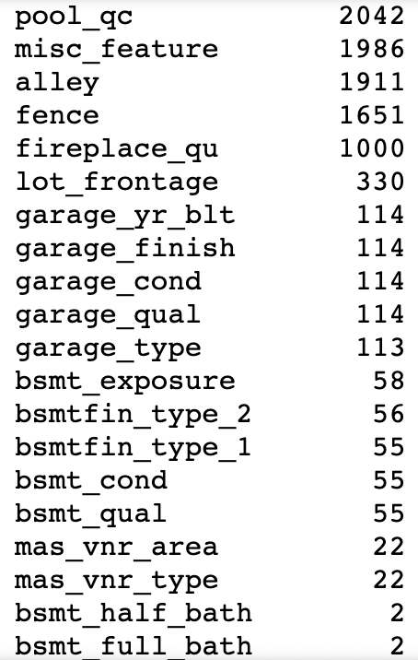
Methodology
2051 data points, capturing everything from municipal zoning to the condition of the fireplaces
Analysis of available features and missing values
Highlighting relationships between features through feature engineering
Model development and testing
Creating future predictions
Number of missing values in the data set

Slide 4
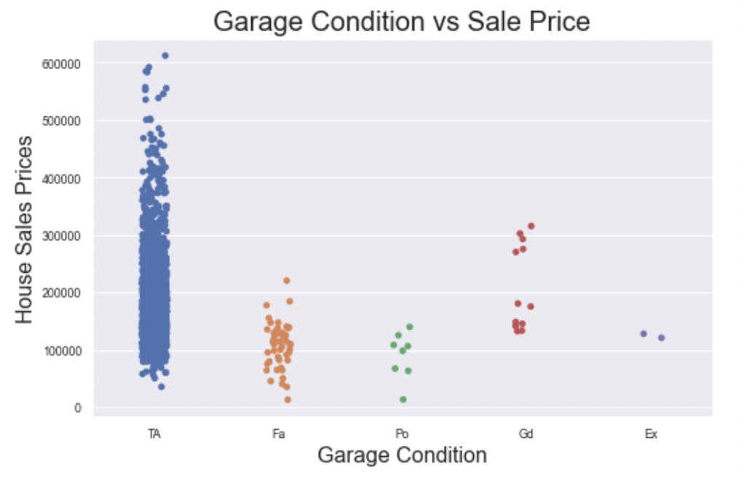
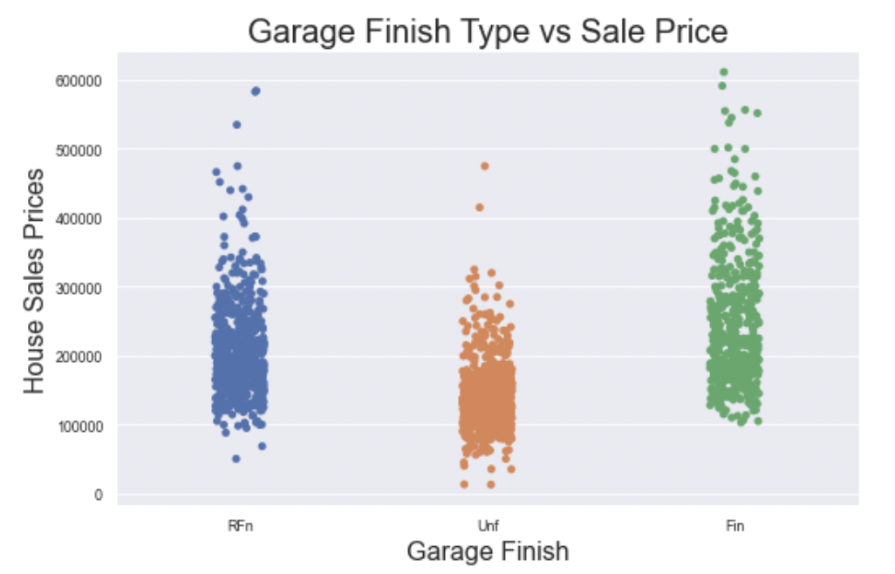
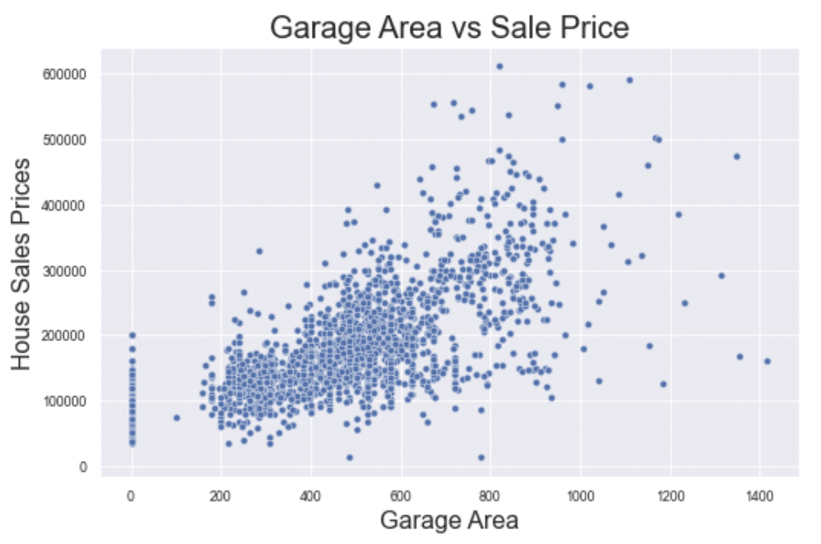
Feature Analysis
Null data as lack of feature, not truly missing data
Identifying ways to enhance feature interactions
Exploring nominal versus ordinal categorical data

Slide 5
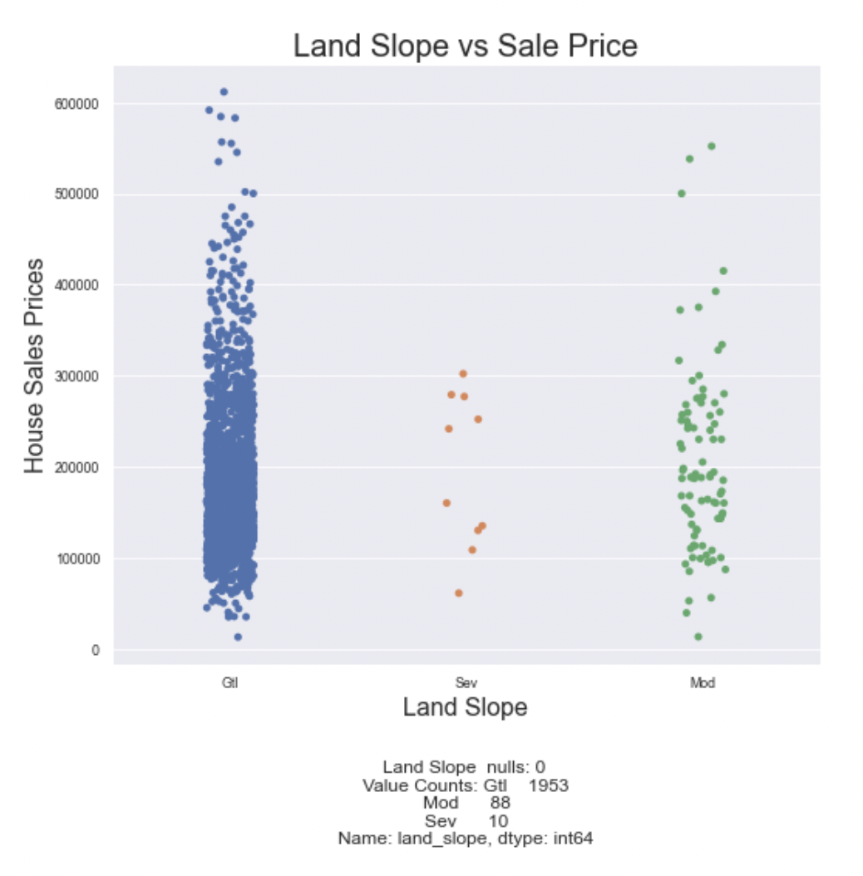
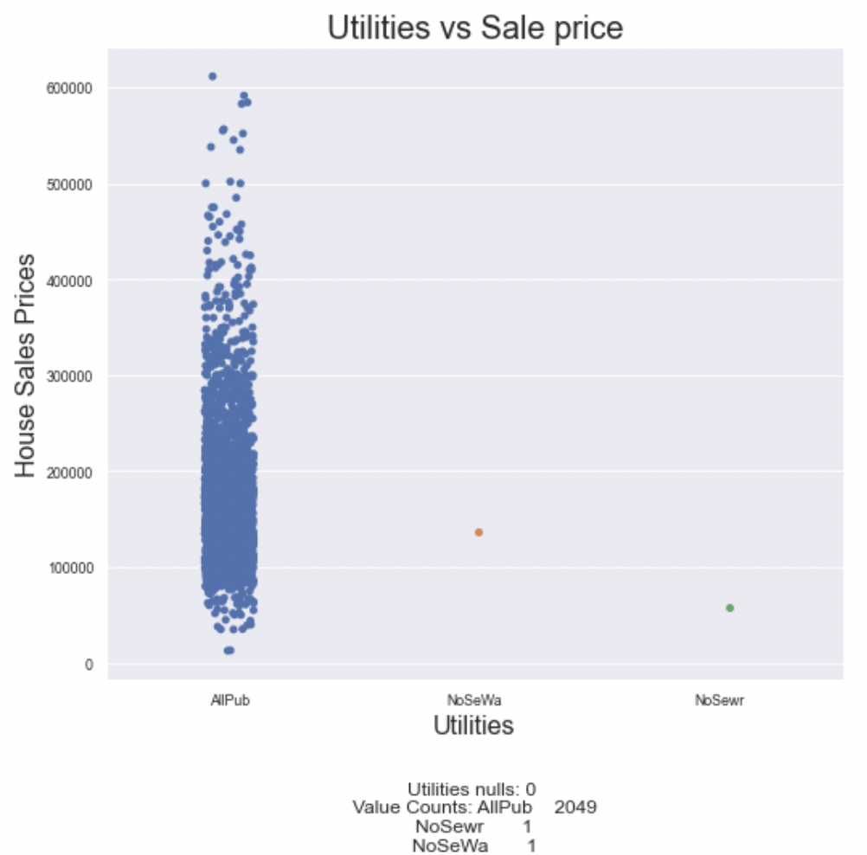
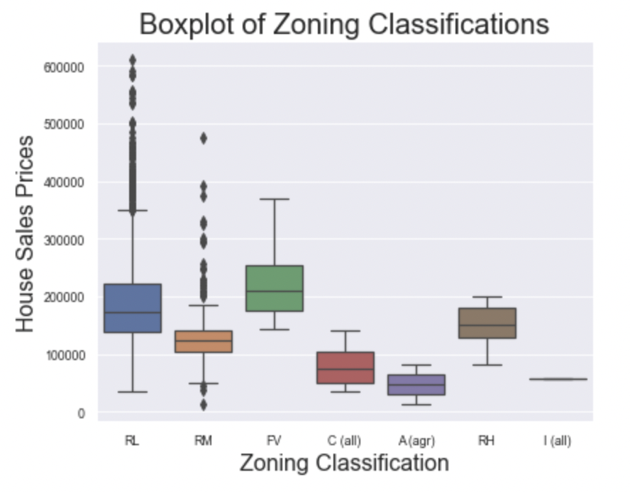
Data Cleaning
Zoning classification consideration
Removing Land Slope and Utilities
Removing outliers in square ft and lot size
Normalizing Sales Prices

Slide 6
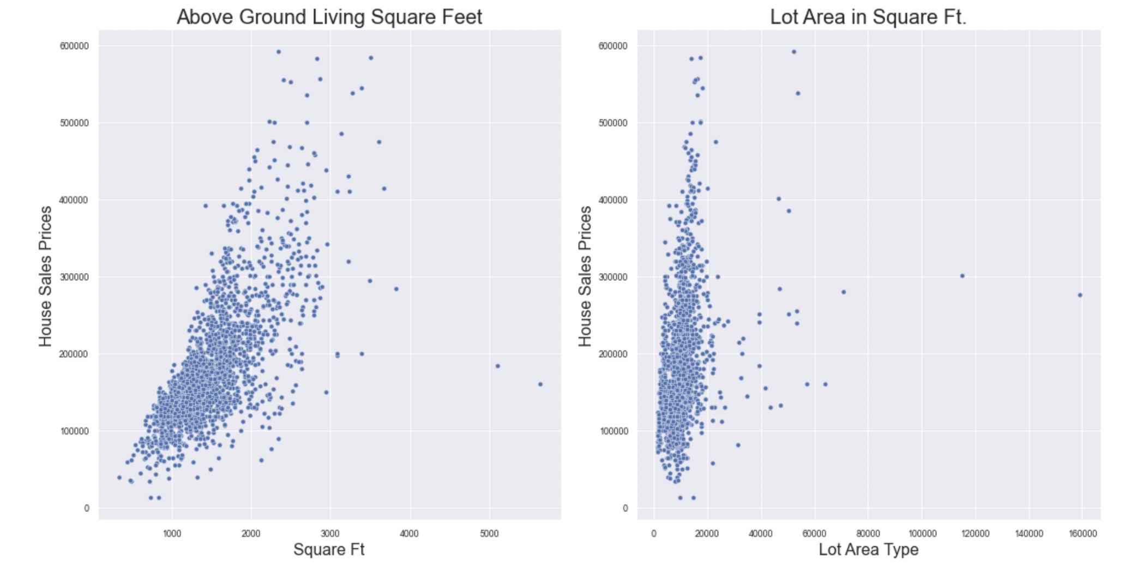

Slide 7
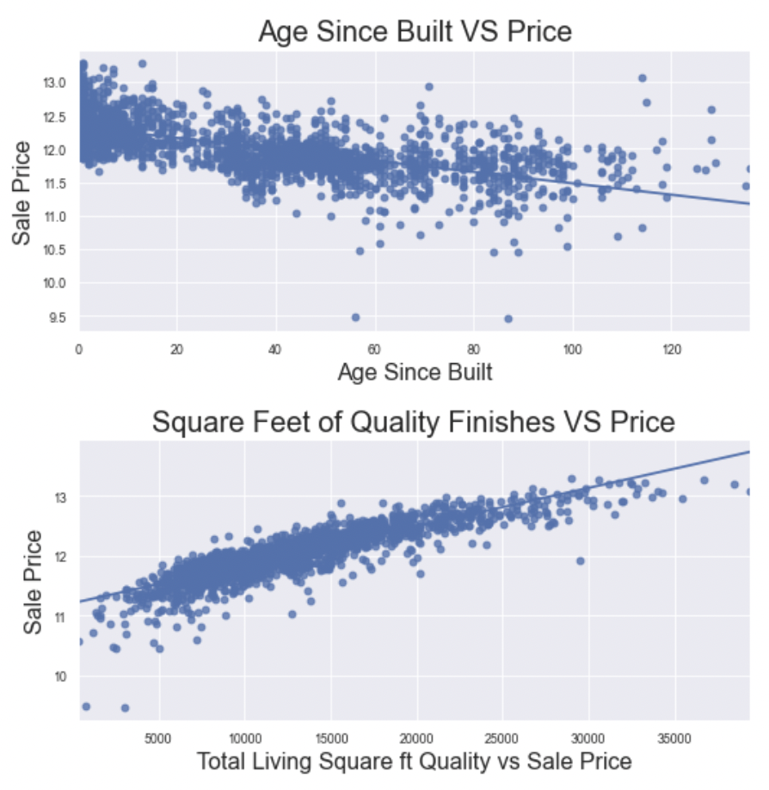
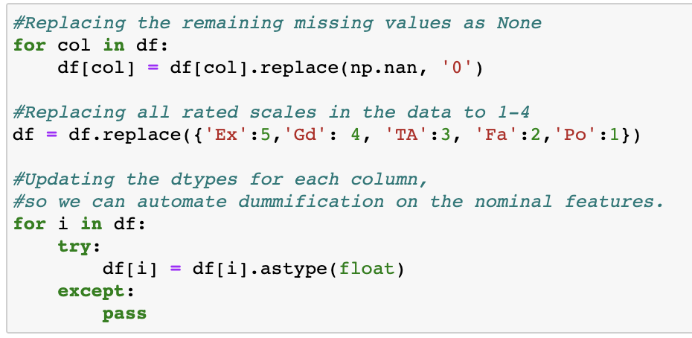
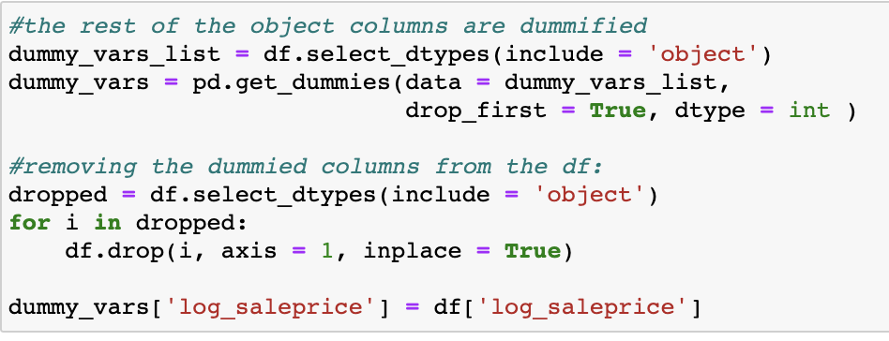
Feature Engineering and Selection
One – hot encoding for ordinal categories, and ‘dummied’ the nominal categories
Created several feature interactions

Slide 8
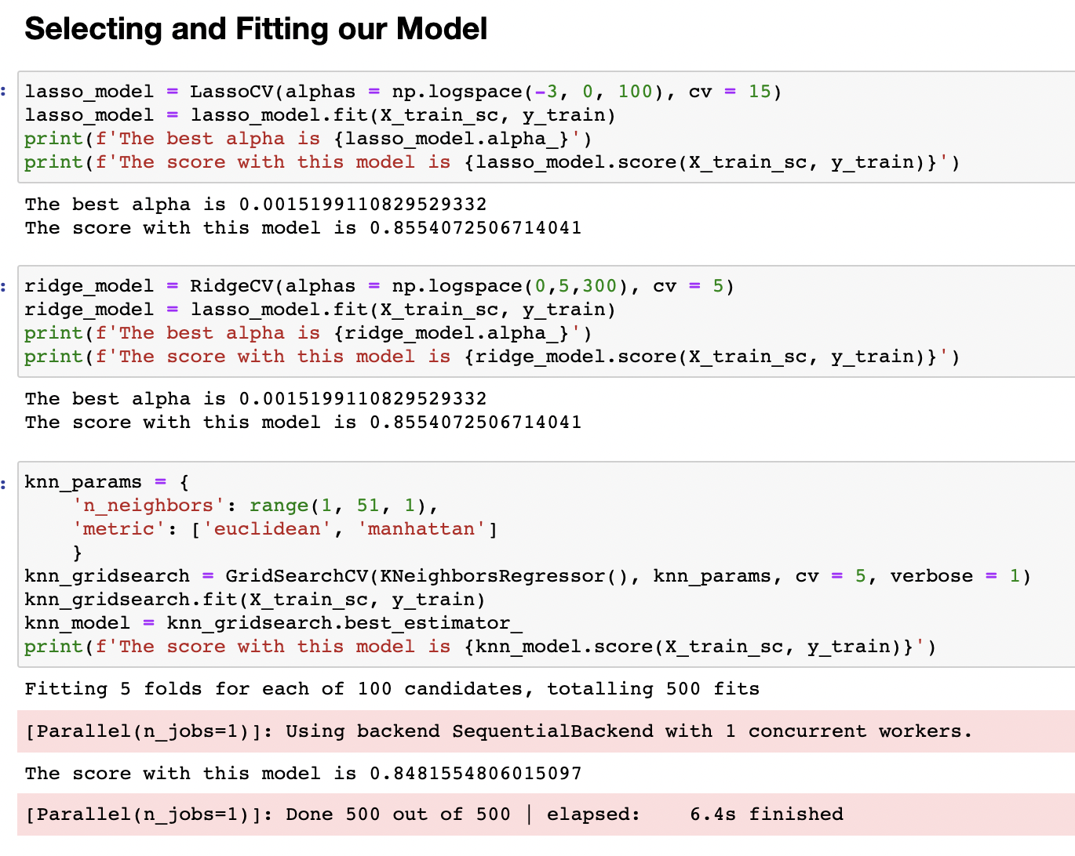
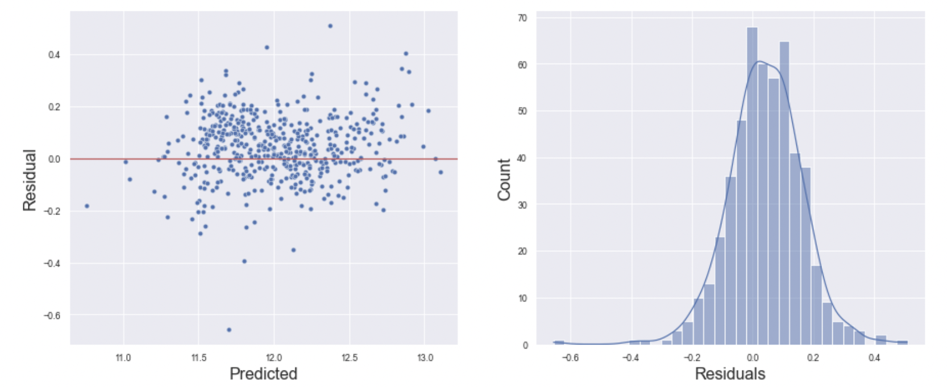
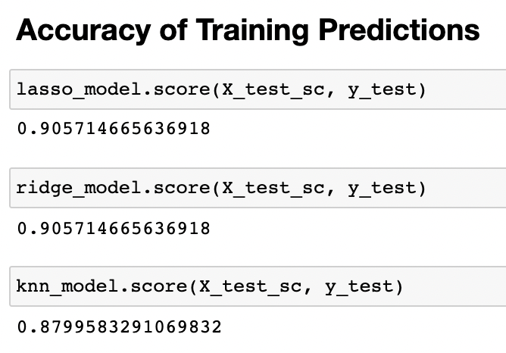
Model Development, Selection and Scoring: An Iterative Process

Slide 9
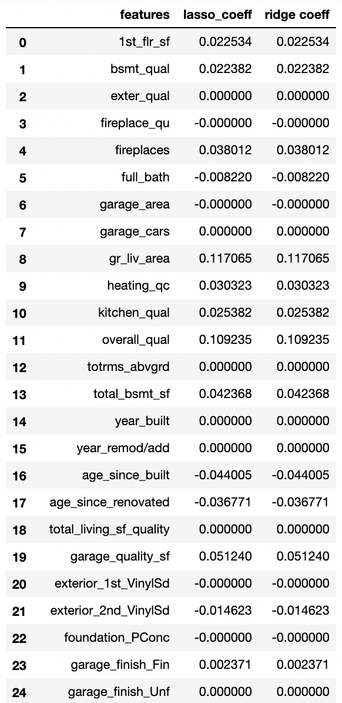
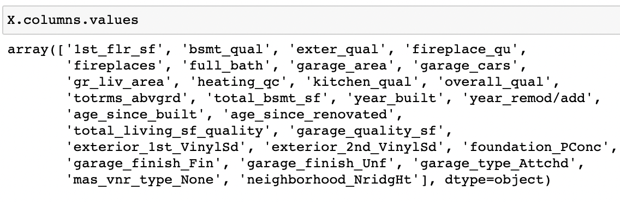
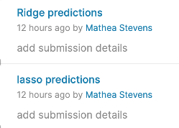
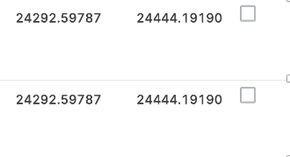
Results

Slide 10
What does all this mean…
The model will predict, based off of 28 various features of a house, it’s sale price within an 87 - 90% accuracy rate.
Negotiation room versus quantitative measurements
Low variance allowing for generalization across municipalities

Slide 11
Thank You and Questions

